Slide 1
Operators and Variables

Slide 2
Session 4
Topic 1: Python Operators
Operators and expressions
Arithmetic operators
Operator priorities
Topic 2: Python Variables
Naming conventions
Identifying keywords
Assigning variables

Slide 3
Python Operators

Slide 4
Operators and expressions
Operators help you manage and control data.
Operators require either variables or expressions to function.
Variables are a named storage source for data (boxes with values in them).
Expressions are mathematical equations or formulas.
Operators take inputs (one or many), perform a task, and provide a task-related output.
Operands are the term given to the specific inputs to an operator.

Slide 5
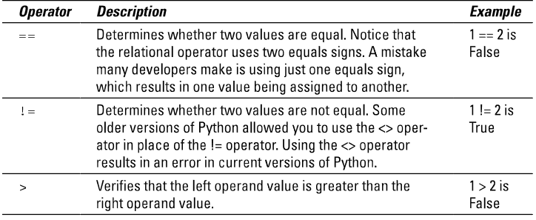
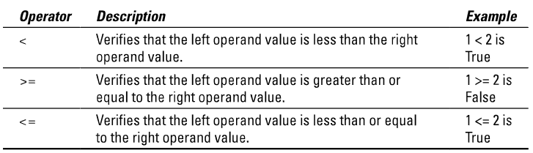
Operators and expressions
Relational operators compare two values and provide information about the relationship they have.

Slide 6
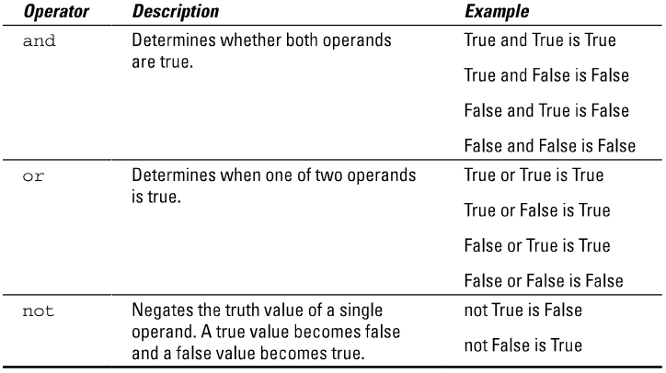
Operators and expressions
Logical operators involve Boolean expressions to determine if they do a specified task based on the truth of the statement. They are also keywords.

Slide 7
Operators and expressions
Arithmetic operators deal with mathematics as a base.
These will be rather familiar from general mathematical equations, and work much in the same way.

Slide 8
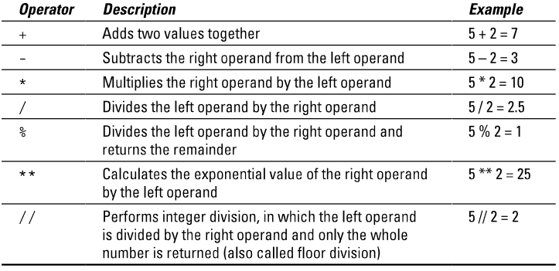
Operators and expressions

Slide 9
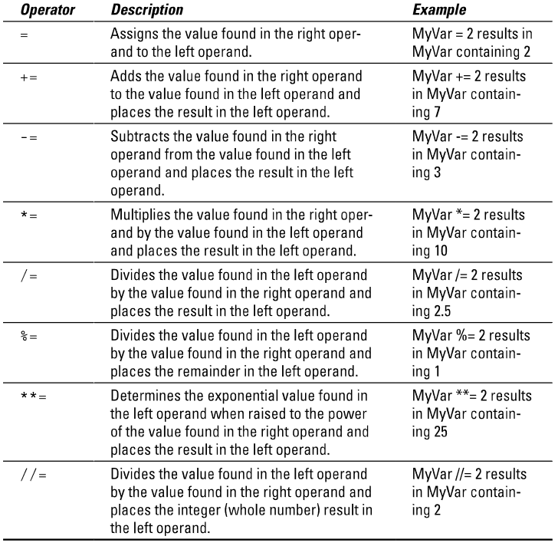
Operators and expressions
Consider MyVar = 5 initially
Assignment operators assign data into variables. These can include arithmetic within the assigning process, making them more efficient.

Slide 10
Python Variables

Slide 11
Naming conventions
There are numerous naming conventions, depending on the code/variable/language type.
We carry on with camelCasing, from pseudocode, for the sake of recognising your own variables.
There are two types of camel case, UpperCamelCase (aka PascalCase) and lowerCamelCase.
Pascal case: PowerPoint
Camel case: iPhone
You can use them how you like, some only use one style, others will use each for different purposes (pronouns and common nouns, or FunctionNames and variableNames).

Slide 12
Naming conventions
As noted in previous sessions there are some rules:
You can’t start a variable with a number.
You can’t have spaces in the variable names.
It can’t be a keyword.
CAPS matter (Variable1 and variable1 are two different variables).

Slide 13
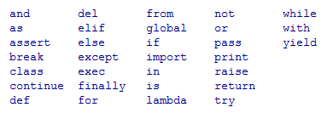
Python Keywords
Python Keywords are a special group of reserved words that have particular predefined uses (we just looked at a few).
You don’t have to know them all yet, we’ll get to them, but look them up, they will be very useful. We’ll cover more of them later on.
You’ll notice them when you’re coding as they show up in a light orange (by default).

Slide 14
Assigning variables
We already touched on assigning variables last week, using the = operator, by using inputs, and by forcing types (int/float/str).
For example:
varMessage = input(“Enter your message”)
varInteger = int(input(“Enter your integer”))
print(“Your message of”, varMessage, “and integer of”, varInteger, “was saved.”)
We now want to look at how they are stored and some things we can do, but before we get into this section, we need to cover the basics of indexes to make full use of the functions.

Slide 15
Assigning variables
In python, whenever there is a list (even a list of characters in a string) it starts the counting of indexed objects at 0.
Even if the value in a variable is a single string, you can analyse it using this functionality.

Slide 16
Assigning variables
So for the list [Red, Blue, Green], Red = 0, Blue = 1, Green = 2.
To break it down further using the same premise, in the string “Red”, the index of the characters is R=0, e=1, d=2.
R | e | d
0 | 1 | 2

Slide 17
Assigning variables
So what would the following give?
red=“Red”
print(red[1])

Slide 18
Assigning variables
So what would the following give?
red=“Red”
print(red[1])
R | e | d
0 | 1 | 2

Slide 19
Assigning variables
A useful in-built function is the len() function. This counts the length of something.
For instance print(len(“How long is this?”)) would result in 17 as the punctuation and spaces still count!

Slide 20
Assigning variables
A useful method is the count() method. Which counts the occurrences of the input. Methods are written differently to functions.
For example:
counting = “Let’s count!”
print(counting.count(“t”))
This would result in 2, as there are 2 of the letter t in the string.

Slide 21
Assigning variables
So far we have assigned variables within our code, all in a singular structure.
However, the def command can allow you to define your own functions, much like print() or len() or other types of functions.
So we have a new way instead of:
sayHello=“Hello”
print(sayHello)

Slide 22

Assigning variables
Let’s make our own simple hello function.
def sayHello():
print(“Hello!”)
sayHello()
sayHello()
sayHello()

Slide 23
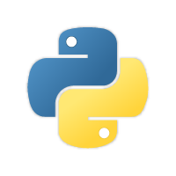

Questions?

